Slide 1

Using game theory to model healthcare behaviours
Michalis Panayides

Slide 2




EMS – ED Interface
NHS Regulations:
Time Waiting < 4 hours

Slide 3

Ambulances outside ED

Slide 4

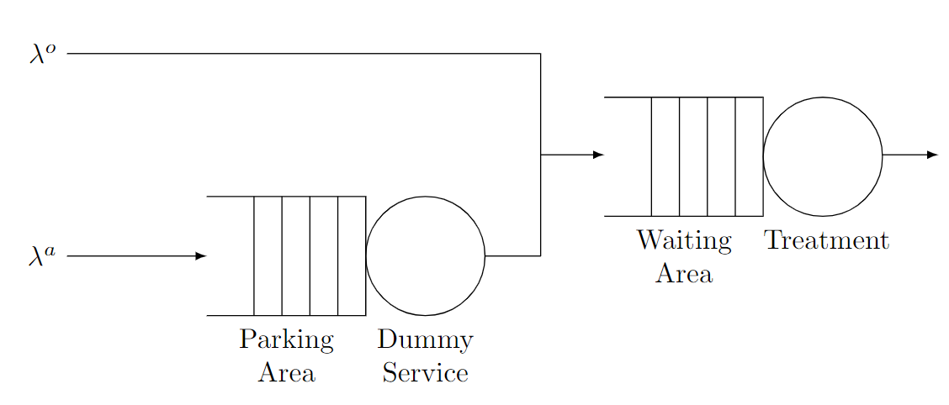
Queueing Model
Blocked Ambulances:
if (number of patients in treatment) > threshold then:
keep individual blocked until otherwise

Slide 5
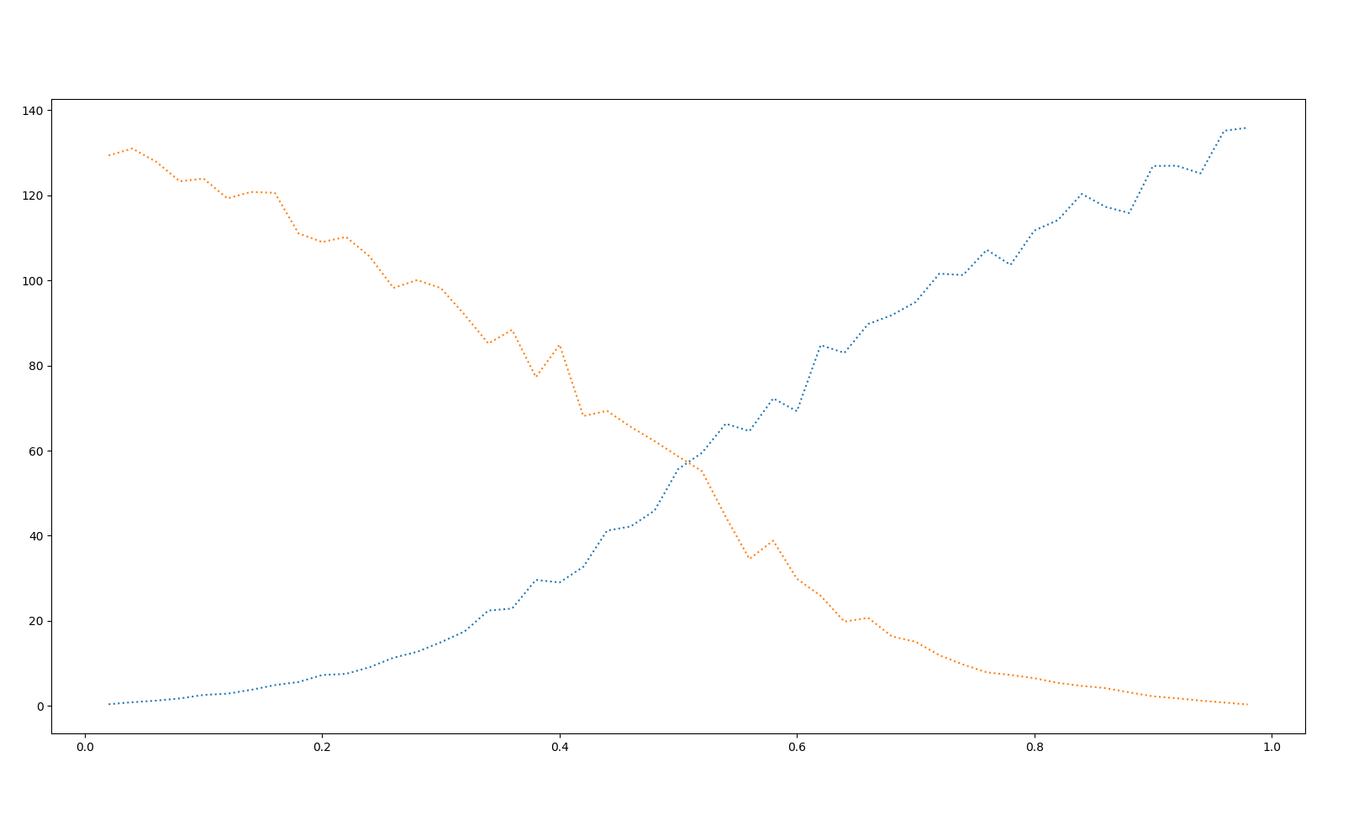
Game between 2 hospitals

Slide 6
THANK YOU

